Slide 1
Emotion-Driven Audio-Visual Experience
CS5170 – AI for HCI
Final Project Presentation
Reality Architects
Aditya Vikram Singh
Ankit Gundewar
Shishir Kallapur
Yifan Tang
{singh.adityav, gundewar.a, kallapur.shi, tang.yifa}@northeastern.edu

Slide 2
Problem Statement
CS5170 – AI for HCI
Final Project Presentation
The Issue
Current multimedia experiences are static and do not adapt to a user’s emotions in real-time.
Lack of seamless integration of AI-generated audio and visual content based on user mood and input.
Why it Matters
Enhancing human-computer interaction through AI-driven emotional experiences.
Potential applications in entertainment, therapy, meditation, and personalized media.
{singh.adityav, gundewar.a, kallapur.shi, tang.yifa}@northeastern.edu

Slide 3
Goal of the Project
CS5170 – AI for HCI
Final Project Presentation
To develop an AI system that generates personalized, immersive audio-visual experiences by understanding the emotional state and intent of the user based on the input provided.
Key Features:
Generating music and visuals to align with user’s mood and intent.
Real-time interaction and enhancements with the environment via webcam and hand gestures.
Iterative feedback loop to tune experience.
{singh.adityav, gundewar.a, kallapur.shi, tang.yifa}@northeastern.edu

Slide 4




What makes it interesting?
CS5170 – AI for HCI
Final Project Presentation
Interactivity: Users influence the generated content based on mood and intent.
Multi-modal AI: Combining music generation, generative art, and real-time input processing.
Human-AI Collaboration: Users guide AI instead of just consuming predefined media.
User Personalization: System can be tuned to learn a specific user’s likes and dislikes
{singh.adityav, gundewar.a, kallapur.shi, tang.yifa}@northeastern.edu

Slide 5
Related Work
CS5170 – AI for HCI
Final Project Presentation
Multimodal emotional cues enhance perception and processing efficiency [1].
The link between paintings and music in emotional expression has been studied through AI-driven music generation [2].
AI-driven text-to-video generation enhances music visualization by mapping textual descriptions to dynamic visuals [3].
[1]A. B. M. Gerdes, M. J. Wieser, and G. W. Alpers, “Emotional pictures and sounds: A review of multimodal interactions of emotion cues in multiple domains,” Frontiers in Psychology, vol. 5, p. 1351, Nov. 2014.[Online]. Available: Frontiers
[2]T. Hisariya, H. Zhang, and J. Liang, "Bridging Paintings and Music – Exploring Emotion Based Music Generation Through Paintings," arXiv preprint arXiv:2409.07827, Sep. 12, 2024. [Online]. Available: arxiv
[3]V. Liu, T. Long, N. Raw, and L. Chilton, "Generative Disco: Text-to-Video Generation for Music Visualization," arXiv:2304.08551, Sep. 28, 2023. [Online]. Available: arxiv
{singh.adityav, gundewar.a, kallapur.shi, tang.yifa}@northeastern.edu

Slide 6
Hypothesis
CS5170 – AI for HCI
Final Project Presentation
Main Hypothesis:
AI-generated personalized audio-visual experience enhances user engagement and emotional impact compared to static media.
Sub-Hypotheses:
Emotion-driven generative content can lead to deeper user immersion.
Interactive elements can increase perceived control and satisfaction.
{singh.adityav, gundewar.a, kallapur.shi, tang.yifa}@northeastern.edu
Notes:
Change in hypothesis. Because of some output being aligned to the user emotion and intent, what should be the hypothesis or potential outcome that we are trying to achieve. talk about affective computing by paul ricard picard

Slide 7
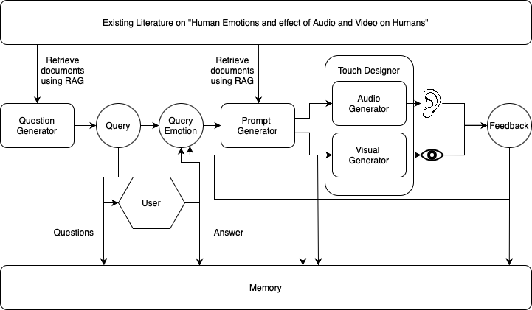
Design
CS5170 – AI for HCI
Final Project Presentation
{singh.adityav, gundewar.a, kallapur.shi, tang.yifa}@northeastern.edu

Slide 8
TouchDesigner Pipeline
CS5170 – AI for HCI
Final Project Presentation
{singh.adityav, gundewar.a, kallapur.shi, tang.yifa}@northeastern.edu

Slide 9
Evaluation
CS5170 – AI for HCI
Final Project Presentation
Survey for users after using the system:
Users first experienced a start-to-end + feedback demo of the project.
Given a short survey to answer about their experience.
5 point Likert Scale method used to present results.
Quantitative metric to check how much a user has interacted (proof of concept)
{singh.adityav, gundewar.a, kallapur.shi, tang.yifa}@northeastern.edu

Slide 10
Challenges
CS5170 – AI for HCI
Final Project Presentation
We could not find a good API based model for music generation. Setting up the MusicGen from Meta was more challenging than expected.
We wanted to create a UI for the user to interact with. Using Streamlit as the UI was challenging.
Setting up the pipelines in TouchDesigner took longer than expected.
{singh.adityav, gundewar.a, kallapur.shi, tang.yifa}@northeastern.edu

Slide 11
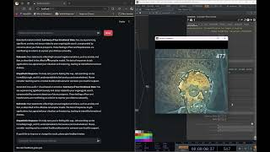
CS5170 – AI for HCI
Project Proposal Presentation
{singh.adityav, gundewar.a, kallapur.shi, tang.yifa}@northeastern.edu
Notes:
Input Emotion: Feeling anxious and stressed due to ongoing job search. Feeling scared about the future
Input intent: Wants to cry out loud and scream into the void.
Output captures some elements of anxiousness and fear, with ominous audio and abstract visuals

Slide 12
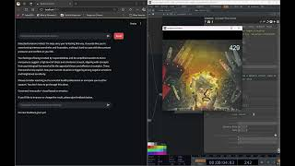
Demo
CS5170 – AI for HCI
Project Proposal Presentation
{singh.adityav, gundewar.a, kallapur.shi, tang.yifa}@northeastern.edu
Notes:
Initial Input Emotion: Feeling frustrated and overwhelmed due to ongoing conflicts in work.
Initial Input intent: Wants to vent out the anger
Initial Output: Aligned more towards positive high energy
Feedback input: User does not like this as he feels its not aligned towards his intent.
Feedback output: Heavy metal music (lol) and aggressive visuals

Slide 13
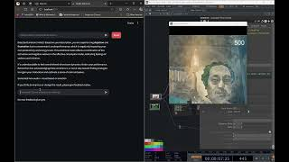
Demo
CS5170 – AI for HCI
Project Proposal Presentation
{singh.adityav, gundewar.a, kallapur.shi, tang.yifa}@northeastern.edu
Notes:
Input Emotion: Dejected and frustrated, causing low levels of productivity
Input intent: Want to feel positive and calm
Output: Uses positive music and pastel color palettes

Slide 14

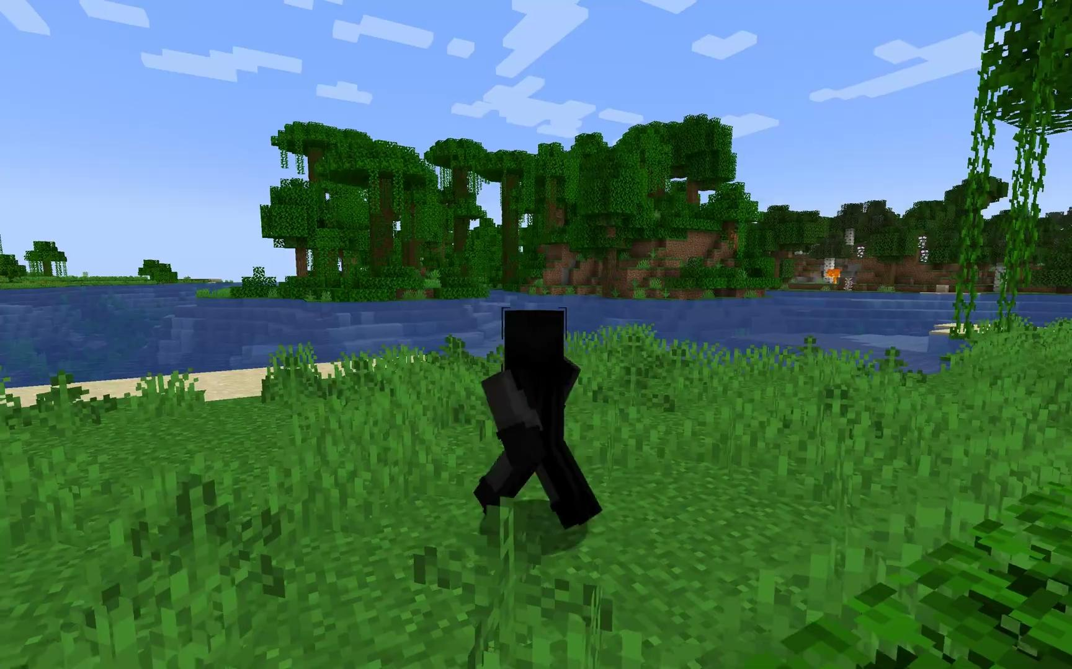
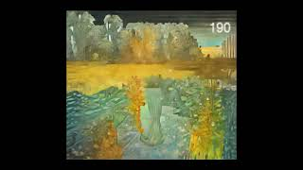

Potential Application of the system
CS5170 – AI for HCI
Final Project Presentation
Emotion: Angry
Intent: Venting
Emotion: Happy, content
Intent: Relax, Reflect
Emotion: Dejection, Frustration
Intent: Feel hopeful
System
{singh.adityav, gundewar.a, kallapur.shi, tang.yifa}@northeastern.edu

Slide 15
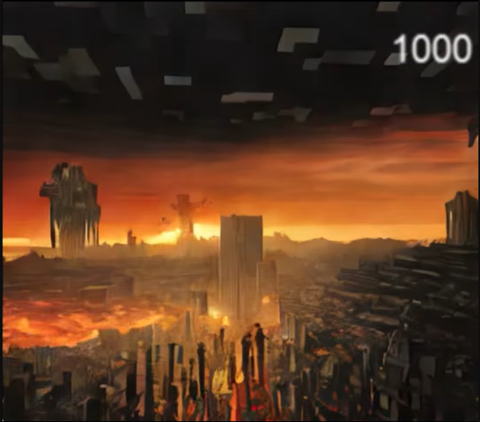
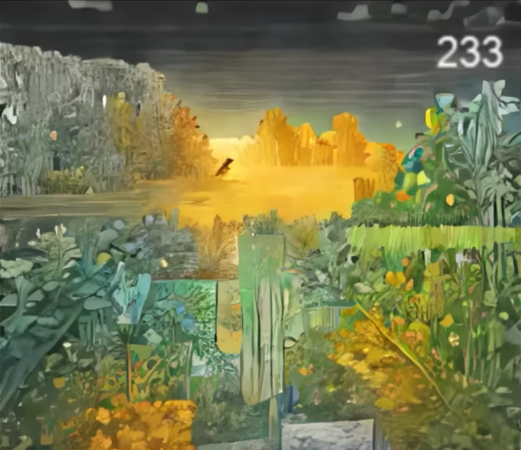
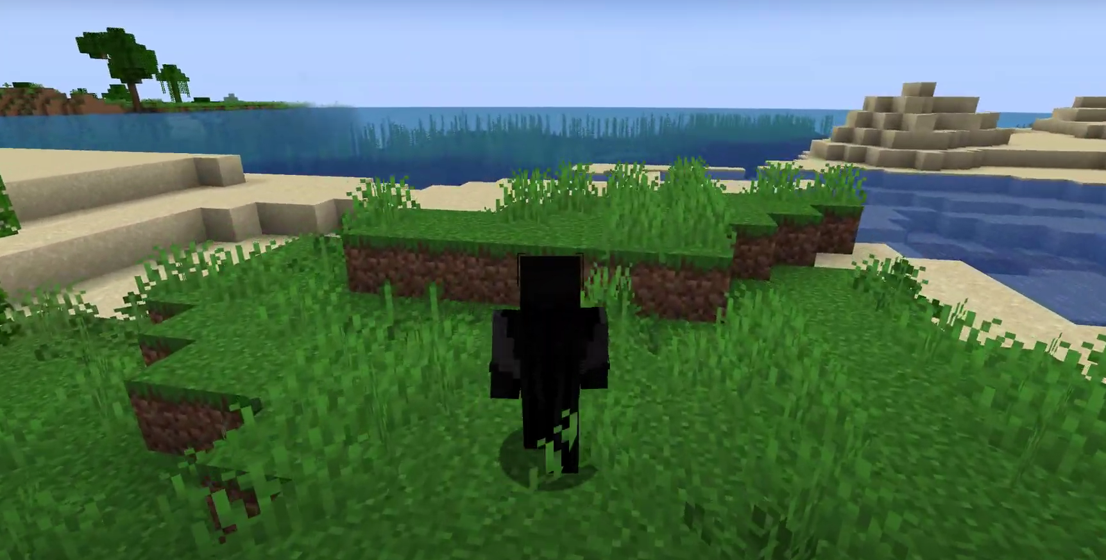
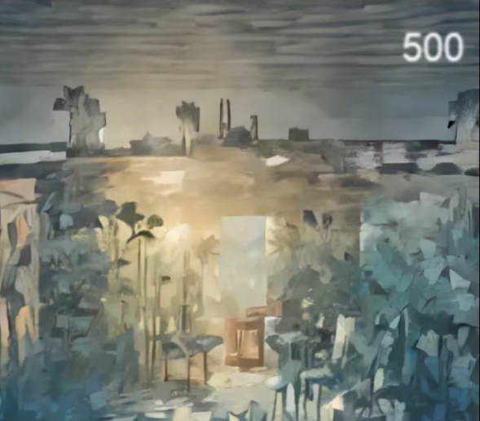
Emotion: Angry
Intent: Venting
Emotion: Happy, content
Intent: Relax, Reflect
Emotion: Dejection, Frustration
Intent: Feel hopeful
System

Slide 16
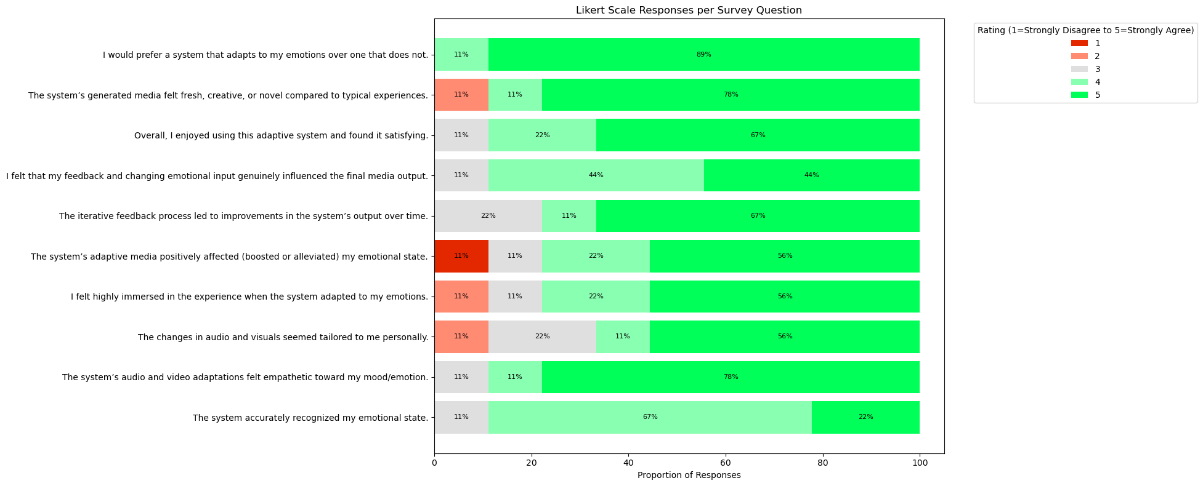
Survey Results
CS5170 – AI for HCI
Final Project Presentation
{singh.adityav, gundewar.a, kallapur.shi, tang.yifa}@northeastern.edu

Slide 17
Thank You!
CS5170 – AI for HCI
Final Project Presentation
{singh.adityav, gundewar.a, kallapur.shi, tang.yifa}@northeastern.edu

